Slide 1

Effect of neighborhood on Yelp Rating of a restaurant
Sahil Aggarwal, Amir Ali, Richard McGovern, Shreya Sabharwal
GROUP 4

Slide 2
Agenda
Research question
Data Pipeline
Feature Engineering
Preliminary analysis
Methods
Results
Concluding remarks

Slide 3
Research Question
‘To what extent does the knowledge of a business’s proximity and other geographic variables improve the accuracy of a model predicting its Yelp score?’

Slide 4
Why?
Most of the work done previously is on text analysis of reviews to predict the Yelp rating of a business.
Not many existing studies examine the effect of the geographical location on the Yelp score of a business.
We wanted to investigate if a business’s success depends on the surrounding businesses or its location on the map in general.

Slide 5
Yelp Dataset
Business features
take-out
delivery
outdoor-seating
credit card payments
reservations
business parking
price range
good for kids or not
Yelp star rating
Neighborhood features
neighborhood labels
latitude
longitude
business categories such as restaurant, hotel, movie hall, pet store, shopping center etc.
Notes:
2:00

Slide 6







Data Pipeline
Raw data in form of JSONs
Cleaning and export of the raw data were done on a virtual machine hosted on Microsoft Azure.
Flattened JSON to a PostgreSQL instance on AWS RDS
Data Cleaning/Preparation in Python
Create Tables/Views
Visualizations/modeling using Jupyter Notebook/ Google Colab
Neighborhood and k-means clusters visualizations in tableau
Spatial processing in R with “simple features” package

Slide 7
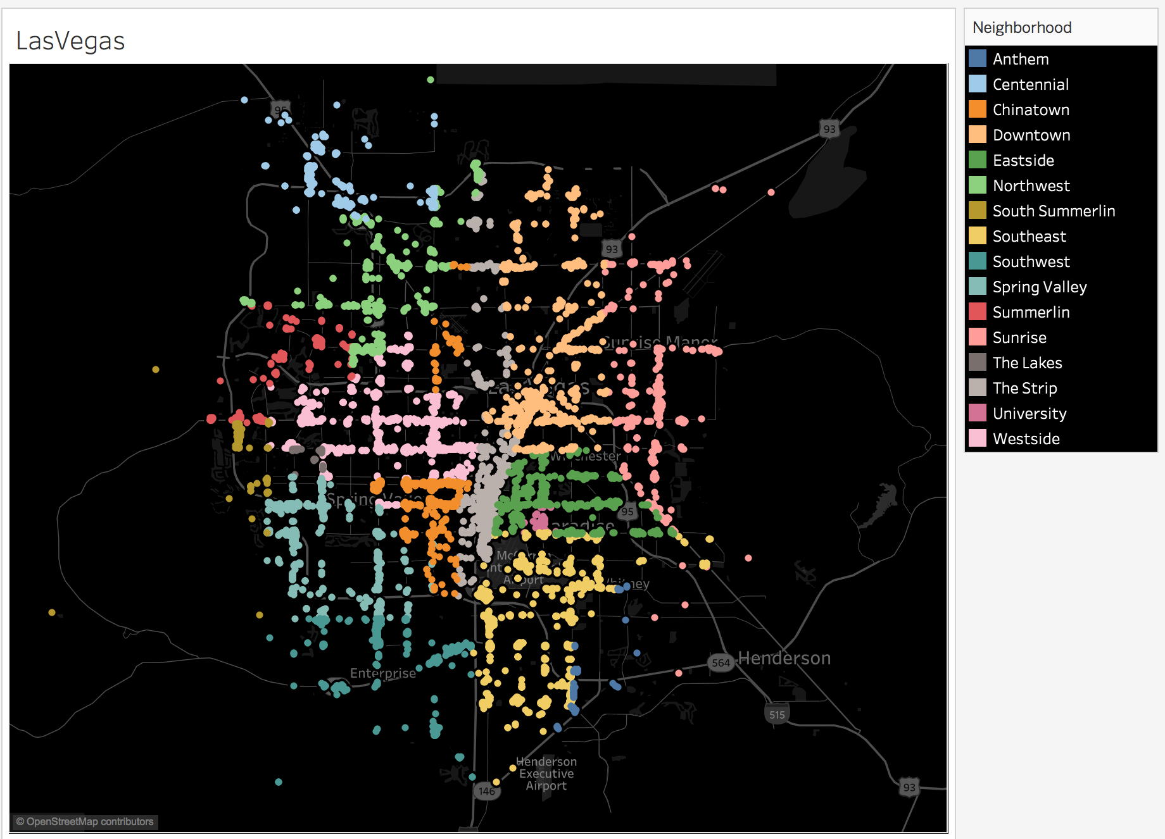
Las Vegas Neighborhoods
Notes:
2:45
---a plot of restaurants
16 neighborhoods. Uniformly distributed in the Las Vegas Map
Anthem: upscale and affluent neighborhood
The Strip: most popular and iconic
Chinatown: famous for its restaurants
Downtown: center of Las Vegas

Slide 8
Missing neighborhood labels
For businesses with missing neighborhood values (~17%) we imputed the values using the neighborhood center with the shortest distance to the business.
We used built-in postgresql functions to compute distances between the businesses and the neighborhood centers using their latitude-longitude.
Notes:
3:25
There were certain restaurants/businesses which were missing the neighborhood tag; we computed these tags using k-means clustering.

Slide 9
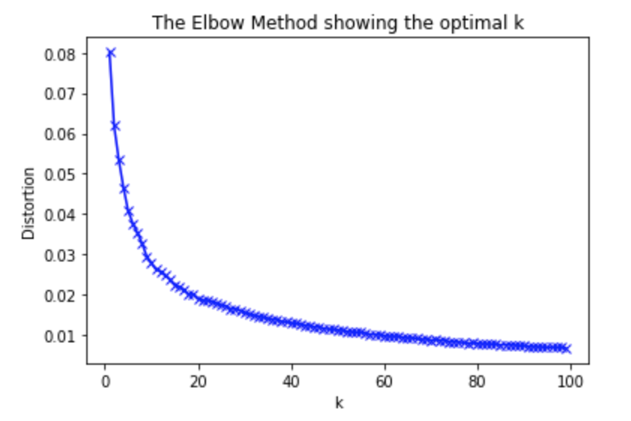
K Means clustering
To find better clusters of restaurants based on the location (lat/long)
Elbow Plot to find the optimal value of k
optimal k turns out to be 16; the same as number of neighborhoods in the dataset
This validates the spread and relative spatial hierarchical level manifested in Las Vegas neighborhoods.
16
Notes:
This was EXPLORATION. Not making a better cluster
Distortion is average variation of distance of points from their assigned cluster centers.
Similar cluster sizes does not necessarily mean that the positions and allocations of the clusters themselves is similar. Culturally they are very different too. Summerlin is white, Anthem is rich, The eastside, including Sunrise is poor, while the south-west has a much older population.

Slide 10
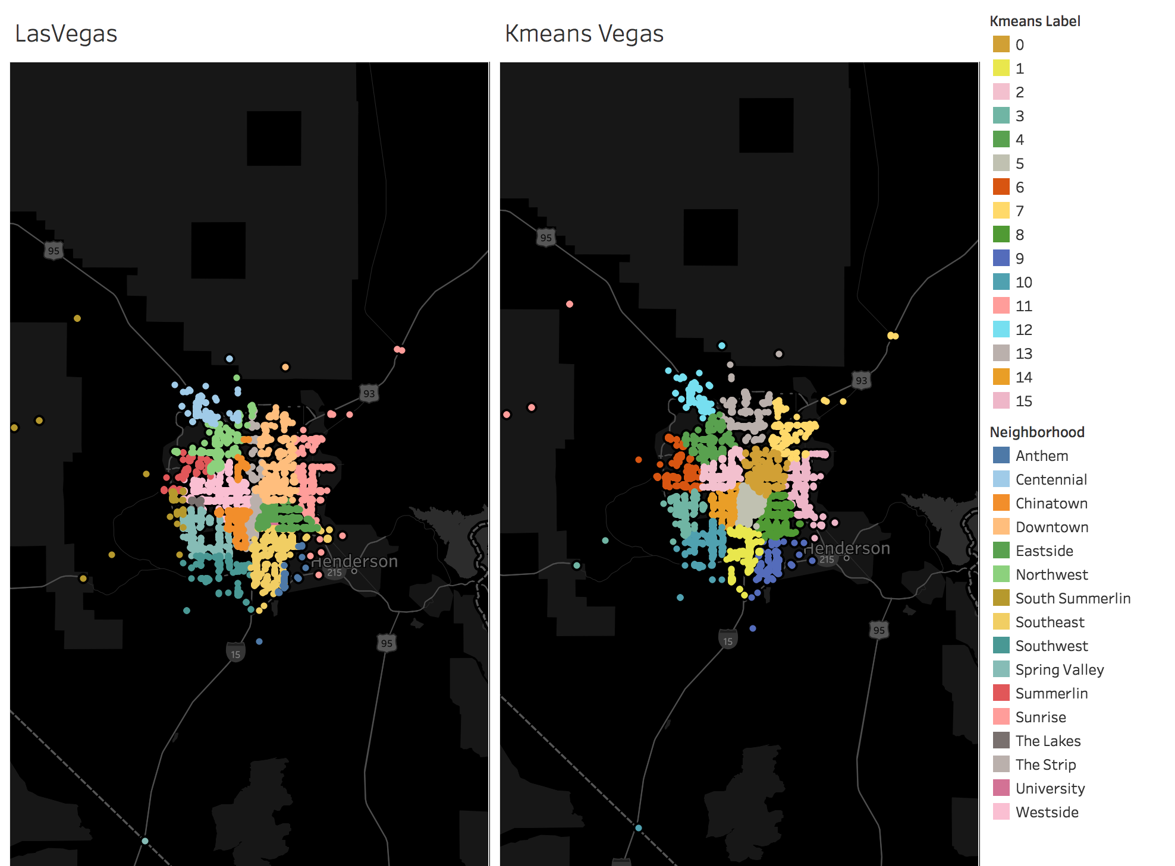
Notes:
Very similar; small changes around the edges. This validated that the neighborhood labels are apt.

Slide 11
Feature Engineering
Within a particular neighborhood:
Business Diversity
Count Aggregates for all 21 categories of businesses
Shortest distances from other business types
Shortest distance from 5 star hotels
Shortest distance from highly rated “arts” such as movie theaters
Average rating of businesses within 100 meters
Shortest distance to the Las Vegas Strip
Added new neighborhood features
Notes:
Began with Las Vegas neighborhood labels.

Slide 12
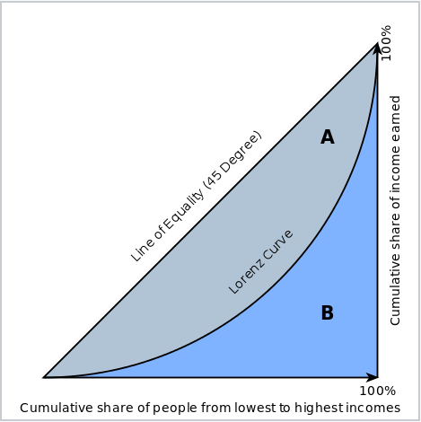

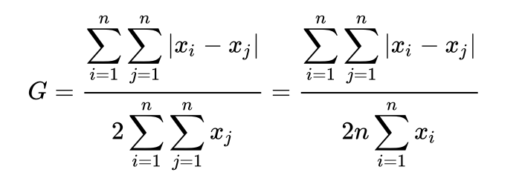
Business Diversity
Business diversity = (1 - Gini Index)
“1” represents a perfectly diverse neighborhood
Measure of diversity
Relative mean absolute difference
Differences in representation of each pair of business categories, normalized by total
Notes:
5:25

Slide 13
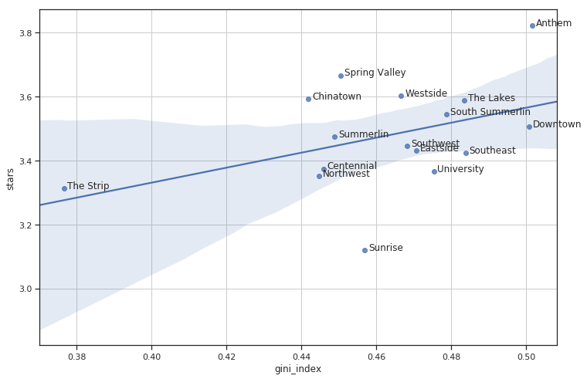
Preliminary Analysis
Yelp Score vs Business Diversity of Neighborhood
slope: 2.34
intercept: 2.39
R-squared: 0.1807
Neighborhoods that have higher diversity tend to have higher star ratings.
business diversity
Notes:
7:00
Bill’s comments - Whether the food is actually better is less clear, but seems very plausible. Discuss this.
‘The Strip’ has the highest number of restaurants, reviews and check ins, but it is not very diverse in terms of other businesses in the neighborhood. As a result, its collective yelp rating is almost the second lowest in Las Vegas.

Slide 14
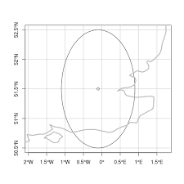
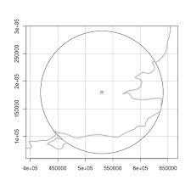
Spatial and Distance Features
R Packages: {RPostgresql} and {sf}
Create point spatial objects
Projected coordinate system in meters
Notes:
Doesn’t look this distorted at the scale of Las Vegas, but distortions can be surprisingly large at a variety of scales.

Slide 15
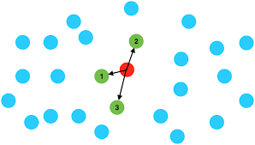
Distance to Nearest Hotels, Theaters, ...
For businesses in each neighborhood:
For each category, find the nearest business to each restaurant
Compute euclidean distance (meters)
Notes:
Replace with map

Slide 16
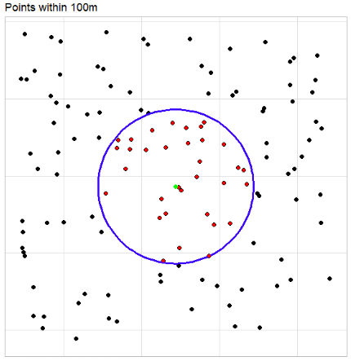
Average Rating within a Proximity
Within each neighborhood:
Computed 100 meter proximity buffers from each restaurant
Spatially joined business point locations to containing buffers
Computed average star rating of businesses within each buffer
Notes:
9:10
The neighborhood proximities yielded aggregate estimate of Yelp rating that were too smooth and statistically insignificant. By taking smaller proximities such as 100m euclidean buffers, we get a better estimate of the restaurant’s rating

Slide 17
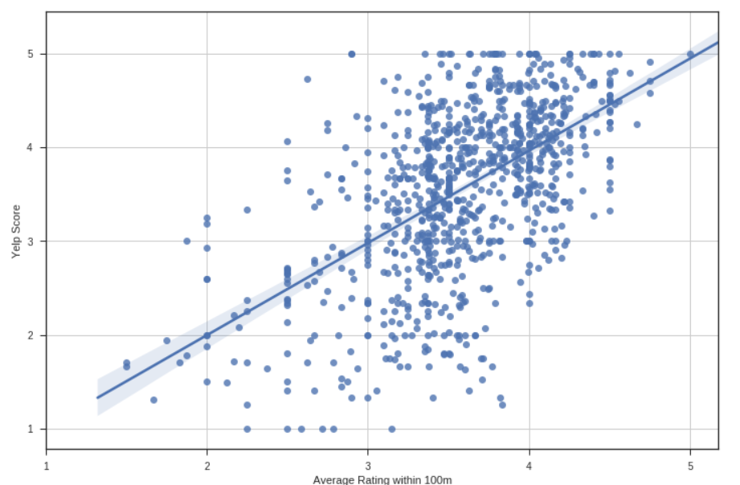
Preliminary Analysis
Yelp Score vs Average Rating within 100m
Neighborhood: Downtown
slope: 0.86 intercept: 0.37 R-squared: 0.2404
The Yelp score increases with the increase in average ratings of businesses within 100m radius.
Notes:
Yelp score is continuous here. This is for a specific neighborhood - Downtown

Slide 18
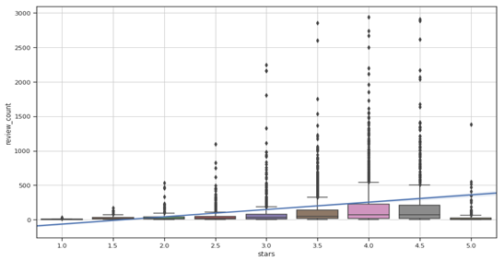
Preliminary Analysis
Yelp Score vs Review Count
slope: 52.87
intercept: -62.75
R-squared: 0.0355
Better restaurants (higher yelp rating) have higher number of reviews.
Notes:
10:00

Slide 19
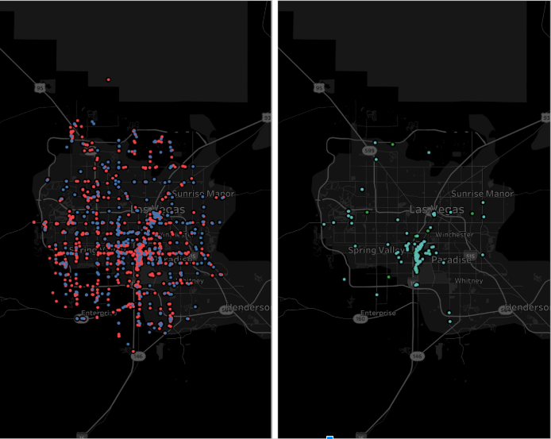
Price Range of Restaurants vs Neighborhood
Price Range 1 & 2
Price Range 3 & 4
The high end expensive restaurants predominantly exist on the Las Vegas Strip
Notes:
the Strip has more expensive and price restaurants

Slide 20
Hypothesis
H₀: There is no statistically significant effect of proximity of a restaurant to other businesses and its geographical location on the Yelp Score
H₁: There is a statistically significant effect of proximity of a restaurant to other businesses and its geographical location on the Yelp Score
Notes:
11:30

Slide 21
Hypothesis Testing/ Analysis Plan
We built two classification models:
Business Characteristics
Business & Neighborhood Characteristics
An improvement in the performance of the former model compared to the later will indicate that there is an effect of neighborhood on the Yelp Score of a business
Perform t-test to identify if the improvement in the accuracy is statistically significant or not
No k-means clustering model for neighborhood as the labels were the the same in most cases

Slide 22
Model 1 - Business Characteristics Only
Multinomial Logistic Regression - Imbalanced Class -- SMOTE; class weights; Stacking
added jitter in the target; performed Linear Regression
score < 4 is 0; score >= 4 is 1
Binary Logistic Regression with ‘l2’ norm with 5 fold CV
Accuracy - 61
Precision - 62
Recall - 27
f-1 score - 38
Random Forest overfits (in-sample accuracy of 99%) and Gradient Boosting (GBM) has a out of sample accuracy of ~63.5%
Review count has the highest coefficient; good for kids is insignificant
Notes:
Precision is defined as fraction of the restaurants which are actually good among all the examples which we predicted are good.
𝑃𝑟𝑒𝑐𝑖𝑠𝑖𝑜𝑛=𝑁𝑢𝑚𝑏𝑒𝑟𝑜𝑓𝑡𝑟𝑢𝑒𝑝𝑜𝑠𝑖𝑡𝑖𝑣𝑒𝑠/𝑇𝑜𝑡𝑎𝑙𝑛𝑢𝑚𝑏𝑒𝑟𝑜𝑓𝑝𝑟𝑒𝑑𝑖𝑐𝑡𝑒𝑑𝑝𝑜𝑠𝑖𝑡𝑖𝑣𝑒𝑠
Recall is fraction of among all the restaurants that are actually good, what fraction did we detect are good?
𝑅𝑒𝑐𝑎𝑙𝑙=𝑁𝑢𝑚𝑏𝑒𝑟𝑜𝑓𝑡𝑟𝑢𝑒𝑝𝑜𝑠𝑖𝑡𝑖𝑣𝑒𝑠/𝐴𝑐𝑡𝑢𝑎𝑙𝑛𝑢𝑚𝑏𝑒𝑟𝑜𝑓𝑝𝑜𝑠𝑖𝑡𝑖𝑣𝑒𝑠

Slide 23
Model 2 - {Business , Neighborhood}
Binary Logistic Regression with ‘l2’ norm
Accuracy - 68
Precision - 88
Recall - 62
f-1 score - 53
Performed forward selection by measuring mean accuracy from cross validation test scores at each step (Dietterich et. al. 1998)
Random Forest overfits, GBM has an accuracy of ~71.2%
Average rating of businesses within 100m, business diversity of the neighborhood, number of hotels in the neighborhood, number of restaurants in the neighborhood were statistically significant.

Slide 24
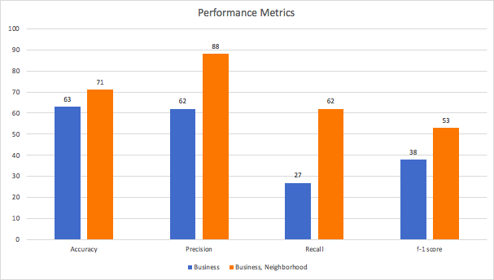
Results
Including neighborhood features improved the accuracy of the logistic regression model by 7.4%.
The difference between the means of accuracies is statistically significant (t-test p = 5.9e-05)

Slide 25
Limitations
Bias of Las Vegas being a tourist spot -- different than the other cities in United States.
Yelp rating doesn’t necessarily predict the performance of a business.
Lacked time-series/forecasting models of Yelp rating given historical data
Lacked text analysis of reviews
Distances are computed “as the crow flies,” not along streets
A lot of missing data for business characteristics
Notes:
16:00
Missing data in almost all business characteristics large proportion

Slide 26
Ethics
Stakeholders: businesses, customers, neighborhood dwellers
Potential impact predicting Yelp scores that are higher than reality for local businesses
Business performance could suffer when they don’t adapt to actual reviews
Potential impact of predicting low Yelp scores in marginalized neighborhoods
Devaluation of those neighborhoods
Residents with different accessibility needs for urban services could be adversely impacted
Notes:
Density/concentration of restaurants is more in “The Strip” neighborhood as compared to other neighborhoods.

Slide 27
Conclusion
We discovered there was a statistically significant increase in performance metrics (accuracy, precision, recall) of a model after adding characteristics of a business’s proximity to the features.
This supports the hypothesis that neighborhood has a positive effect on the Yelp score of a restaurant.
Notes:
Density/concentration of restaurants is more in “The Strip” neighborhood as compared to other neighborhoods.

Slide 28
Next Steps
Create features like population demographics for a neighborhood from the census data
Account for restaurant diversity with sub-categories of restaurants (such as thai, indian, chinese)
Compute walking distance along the street network instead of shortest distance
Create a model comparing other proximity definitions (kmeans, 100m buffers, etc)
Compute density of businesses within each proximity
Reproduce the model on a different city with more neighborhood heterogeneity
Neural network to learn more complex patterns
Notes:
18:00

Slide 29
Thank You
Questions?

Slide 30
References
T. G. Dietterich, "Approximate Statistical Tests for Comparing Supervised Classification Learning Algorithms," in Neural Computation, vol. 10, no. 7, pp. 1895-1923, 1 Oct. 1998.
doi: 10.1162/089976698300017197
URL: http://ieeexplore.ieee.org/stamp/stamp.jsp?tp=&arnumber=6790639&isnumber=6790370
Yelp Restaurants Dataset. 2018. URL: https://www.kaggle.com/yelp-dataset/yelp-dataset

